Slide 1
Data Analytics and Visualization Final Project
NY citiBike Program: Bike Availability Predictor
Sarah Mwanzi
Soumya Patil

Slide 2
Project Overview
NYC citiBike:
A bike share program with stations throughout NYC that a rider can pick up and return a bike to.
Previous Project:
Analysis of usage and popular stations/trips
Problem:
No available bikes at popular stations during popular times
Goal:
Given a start station and time of day/ day of week for a trip start, predict the availability of a bike at the start stations using Machine Learning Models.

Slide 3
Data Overview
Real –Time Data was scraped from https://www.citibikenyc.com/system-data .
Scraped using python script/ SQLAchemy and stored in Postgres / uploaded to AWS 3
minute-by-minute update of the number of bikes and number of docks available
trips: trip-level records, includes date, start/end time, start/end station ID, start/end station name, bike ID, rider subscription type, and trip duration

Slide 4


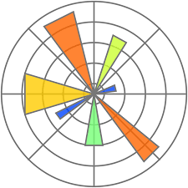




Project Requirements:
Technologies used:
Scikit-Learn
Python Pandas
Python
Matplotlib/Seaborn
PostgreSQL
Amazon AWS
Numpy
SQLAlchemy

Slide 5
Exploratory Data Analysis
Paired Scatter Plot
No clear correlation between the variables.
The data set meets the requirements of a classification model

Slide 6
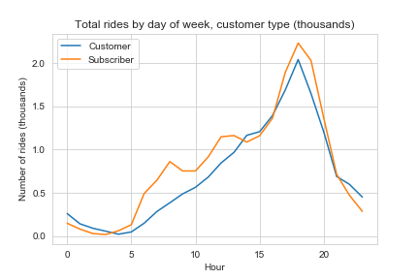
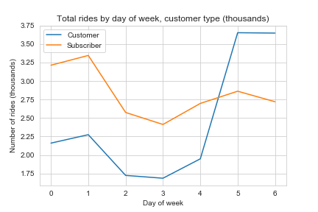
Exploratory Data Analysis
Ridership Trends
Ridership peaks early to late evenings
Mondays and Weekends see the most riders

Slide 7
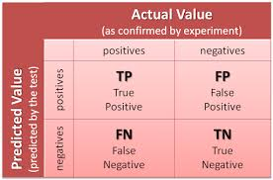
Machine Learning Models:
Classifiers
Logistic Regression
Random Forest
SVC
K-Neighbors

Slide 8


Assumptions
Binary logistic regression - the dependent variable is binary.
The factor level 1 of the dependent variable represents the desired outcome.
Only meaningful variables should be included.
The independent variables are independent of each other, the model should have little or no multicollinearity

Slide 9
Challenges/limitations
Setting up the data scraping scheduler.
Needed at least a 2 weeks of data
Data processing – dates and timestamps conversions.
Time constraints.

Slide 10
Future projects
HEADLINE TEXT
This dataset holds rich potential for further feature engineering, including:
Adding weather features and Mapping zip-level daily weather data with each station
Using data over a longer period.
Creating a citibike availability predictor application

Slide 11
RESOURCES
SUMMARIZE PROJECT RESOURCES
Dedicated (full-time) resources
Part-time resources
If project is constrained by lack of resources, suggest alternatives
UNDERSTAND WHAT CUSTOMERS WANT
Customers may want to be assured that all possible resources are being used, but in such a way that costs will be properly managed

